Slide 1
Predicting Default in Credit Card Payment for the Next Month
Ibiyengha Tobin - 301256083

Slide 2
Table of contents
Data Exploration
01
Objectives
02
03
Model
04
Conclusion
The problem statement and the executive summary
Data Exploration Techniques and Data Cleansing
Logistic Regression, KNN, Random Forest and Decision Tree`
Model Limitation and Recommended Next Steps

Slide 3
01
Objectives
Problem Statement and Executive Summary

Slide 4
Problem Statement
Credit card default has a significant impact on the financial institutions giving out these credit cards.
The performance of a financial institution's portfolio as a whole can be severely impacted by credit card defaults.
Consistently high default rates can damage a financial institution's reputation and weaken consumers' trust.

Slide 5
Credit Liabilities of Households in Canada

Slide 6
Executive Summary
Recommendations for Financial Institutions
Developed a Predictive Model
Identified Important Factors

Slide 7
02
Data Exploration

Slide 8
Data Overview
Data Cleansing
Data Visualization
Data Preparation
Records of Data, Columns, Data Types
Detection and Removal of Outliers
Bar Graphs, Box Plots, Pie Charts, Heat Map
Data Normalization, Dividing the dataset

Slide 9
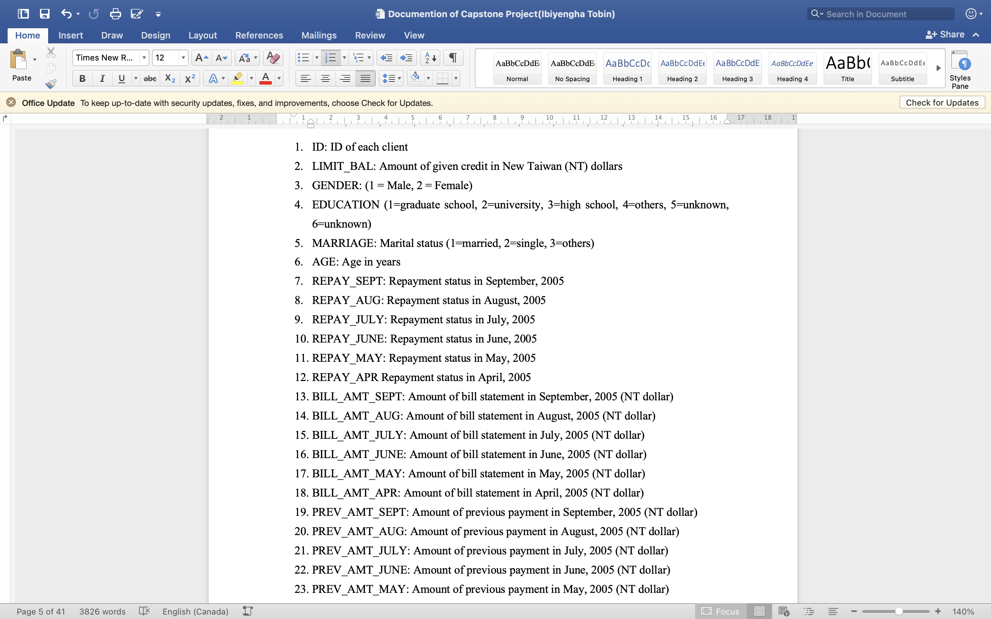
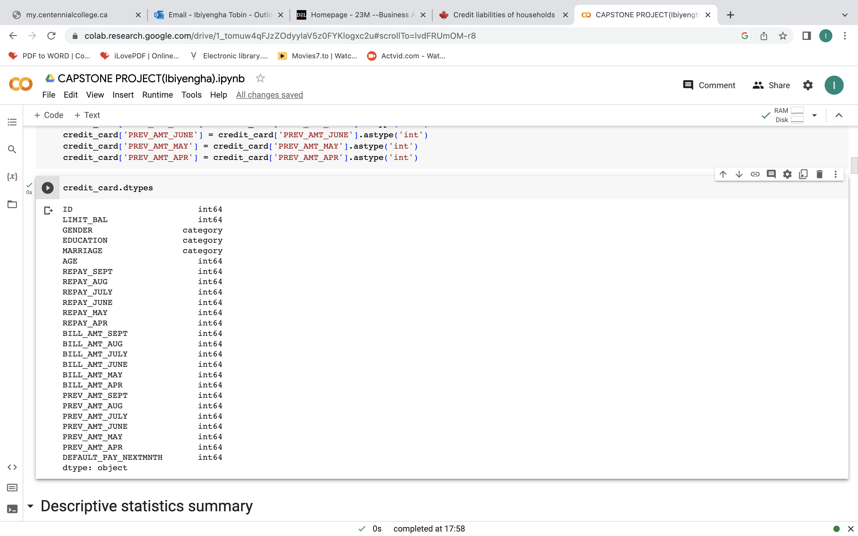
Data Overview

Slide 10
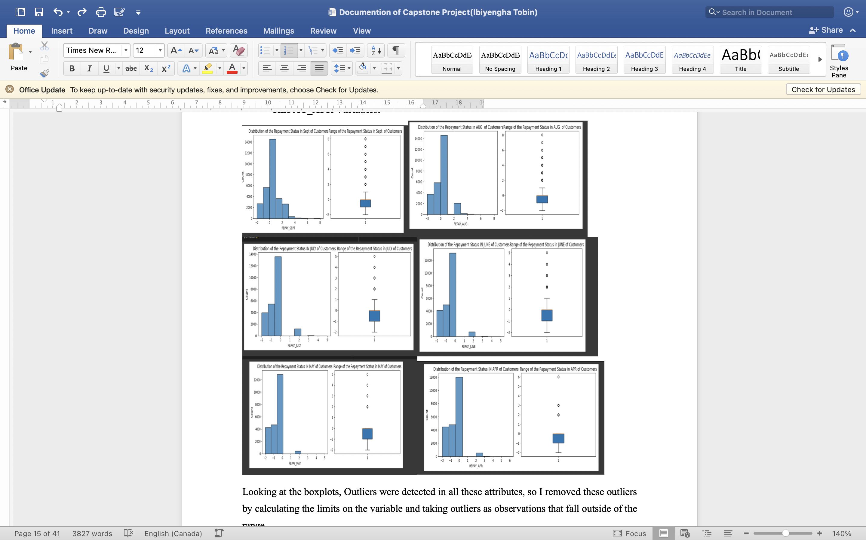

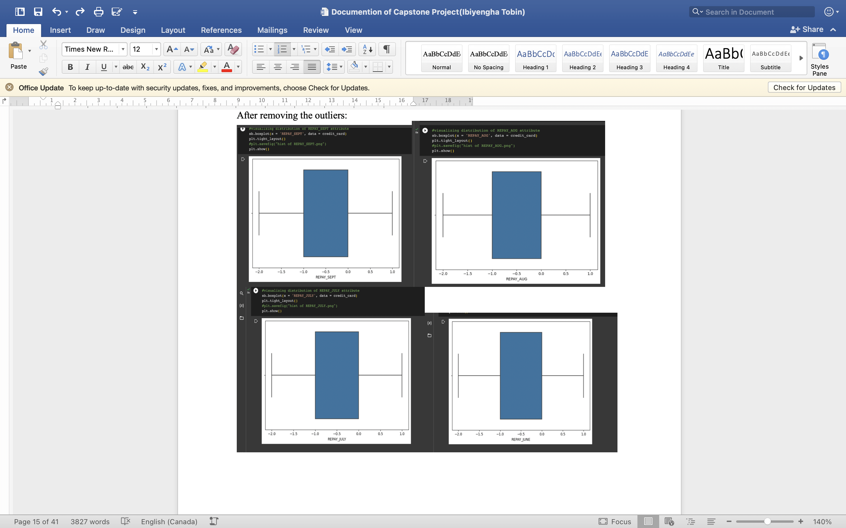
Data Cleansing
Outliers were detected using boxplot
Dealt with outliers using Quantile Method
Removed all potential Outliers

Slide 11
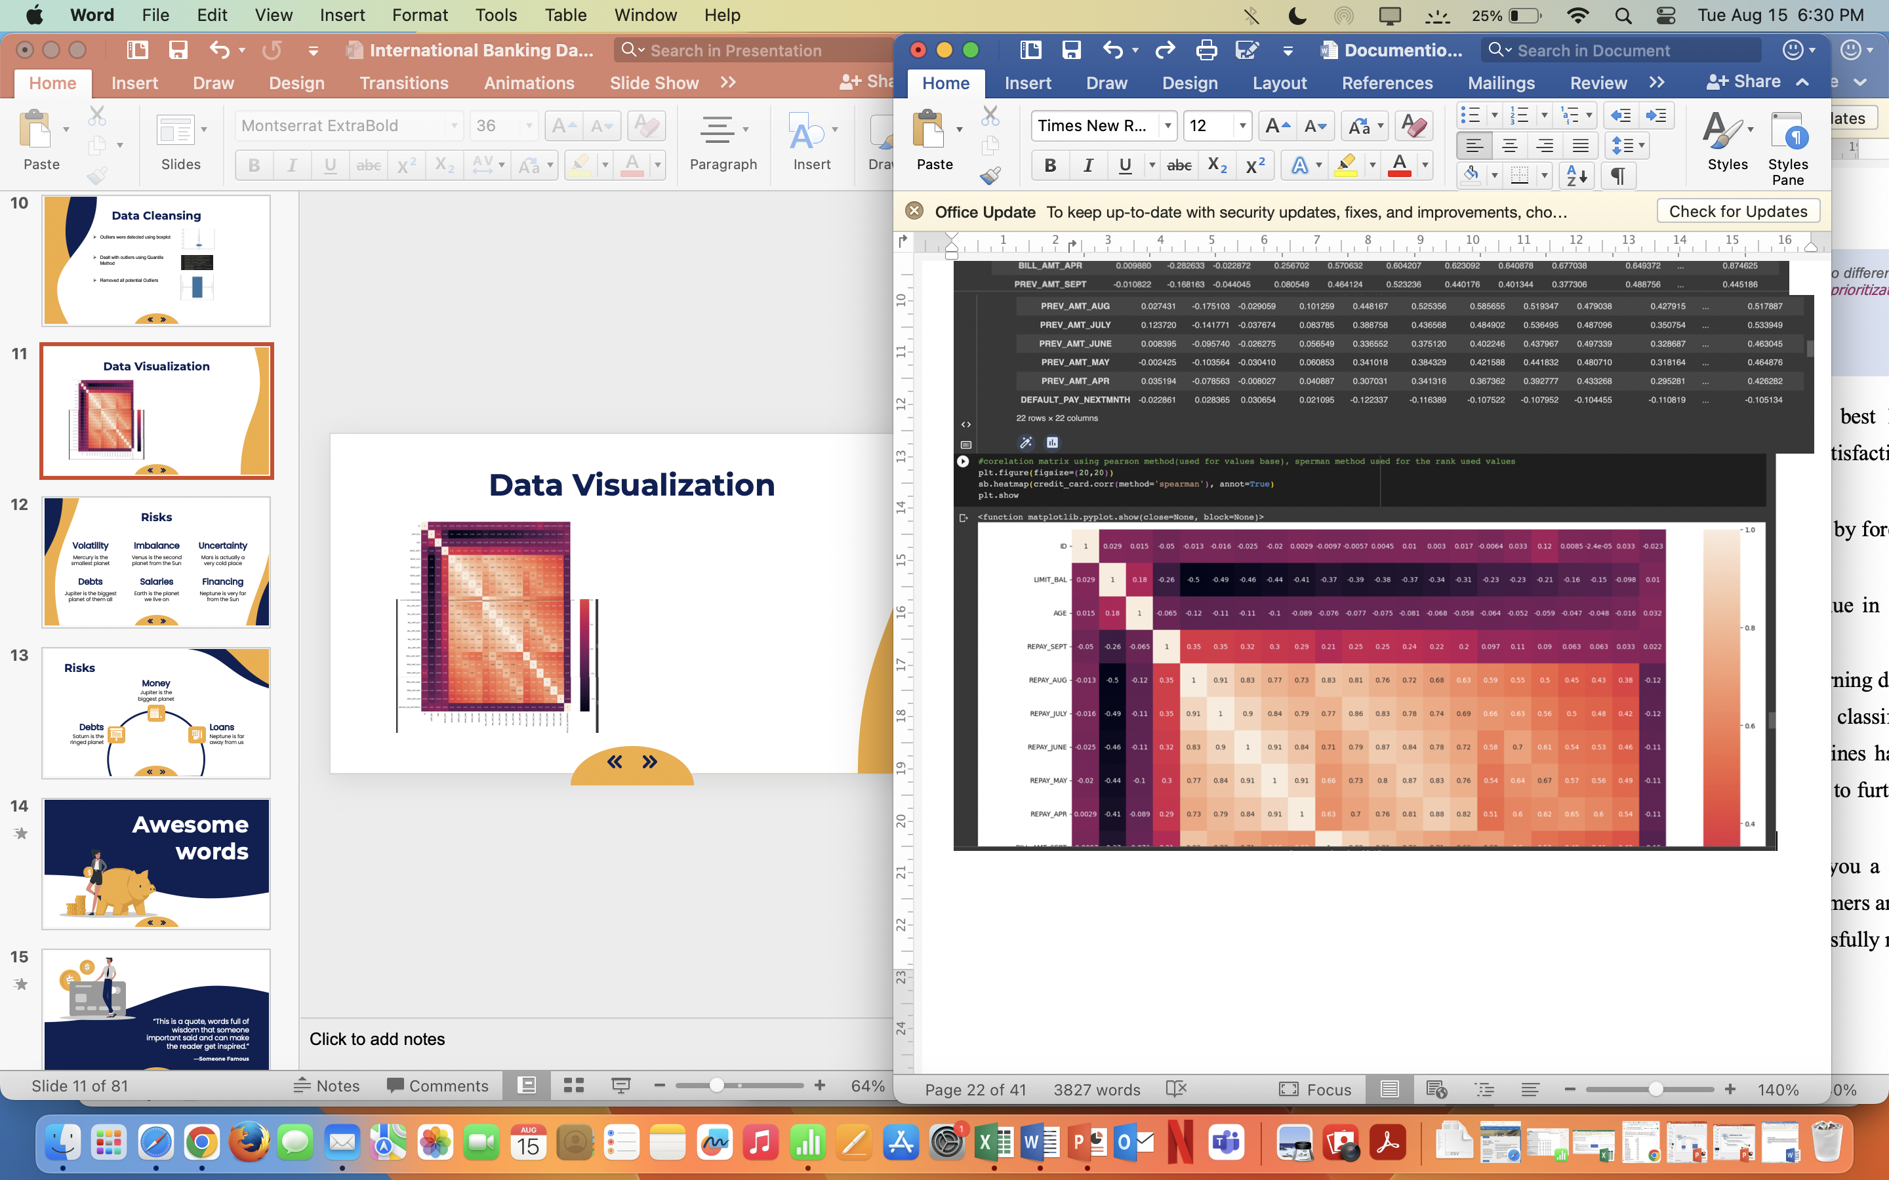
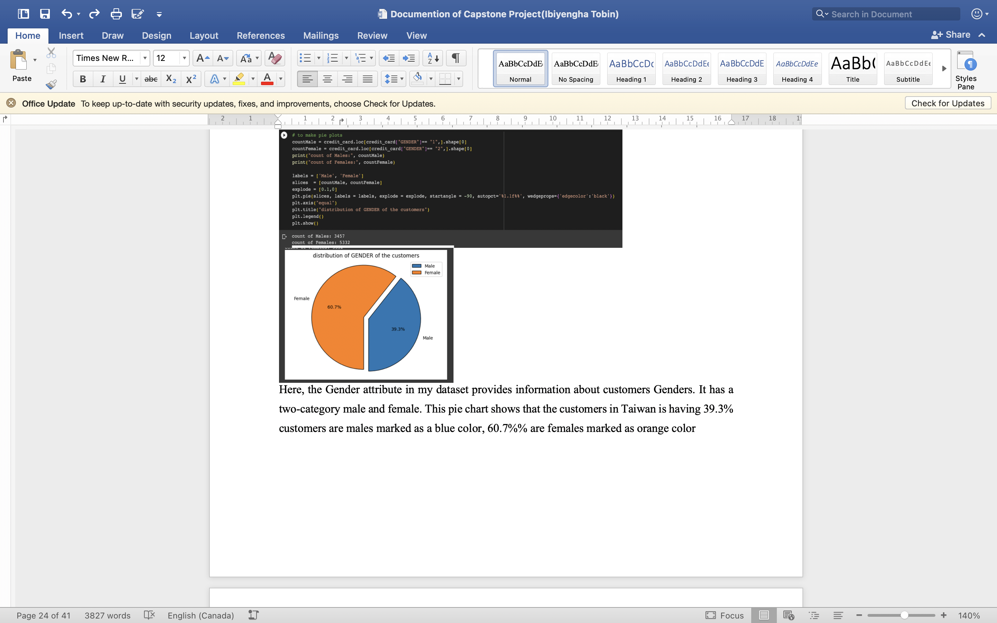



Data Visualization

Slide 12
Data Preparation
Divided Data into Train Test Split
Train(Training the model)
Test(Evaluating the Model)
Data Normalization
SMOTE
For balancing the Target Variable
Before After
0 - 5808 0 - 5808
1 - 1223 1 - 5808
To reduce redundant variables

Slide 13
Model
03

Slide 14
Models Evaluation
 | Accuracy Score | K-FOLD | Strati_K_fOLD
Logistic Regression | 58.93 | 0.8272 | 0.8260
KNN | 58.25 | 0.8032 | 0.8003
Random Forest | 79.64 | 0.8258 | 0.8234
Decision Tree | 70.59 | 0.6920 | 0.7218

Slide 15
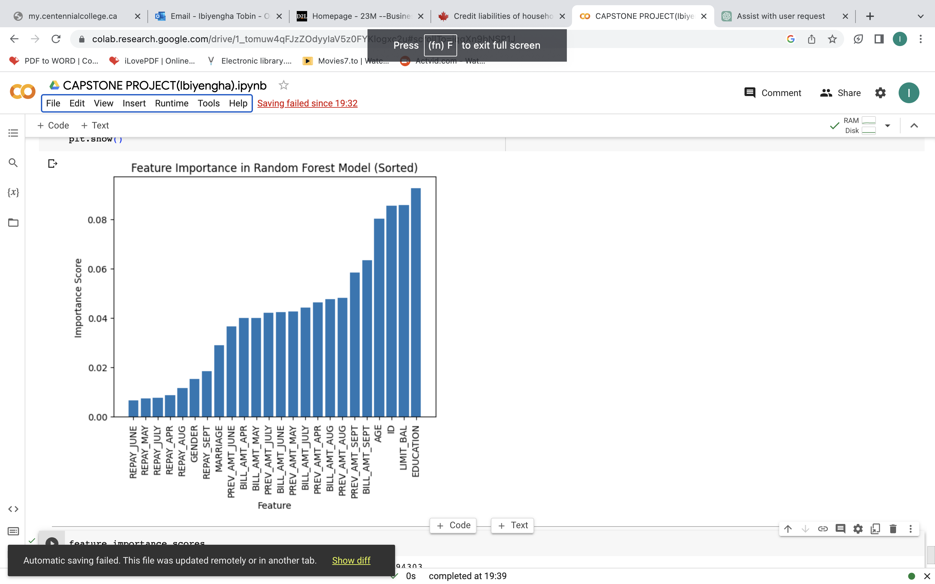
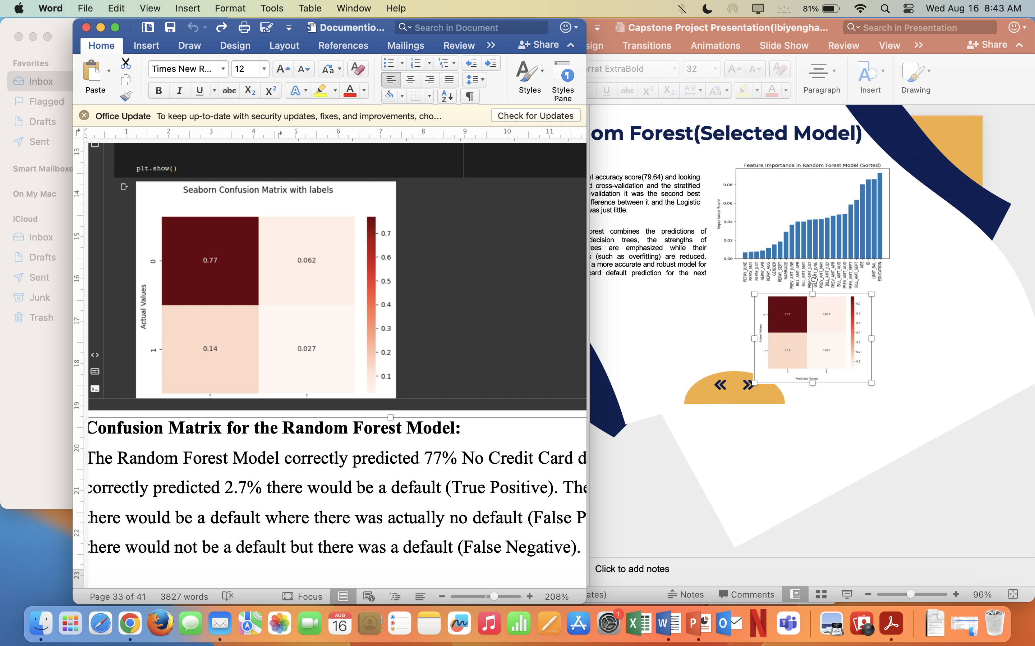
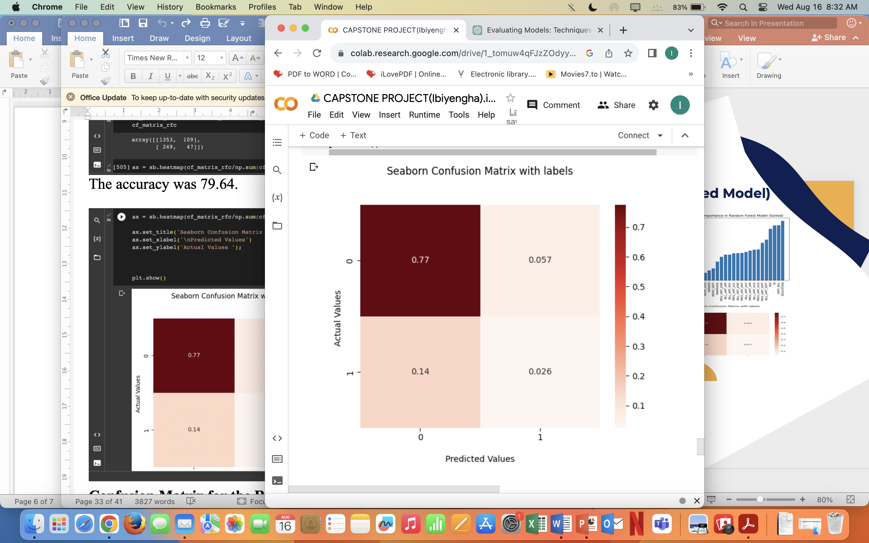
Random Forest(Selected Model)
It has the best accuracy score(79.64) and looking at the K-Fold cross-validation and the stratified K-fold cross-validation it was the second best model, the difference between it and the Logistic Regression was just little.
Random Forest combines the predictions of numerous decision trees, the strengths of individual trees are emphasized while their shortcomings (such as overfitting) are reduced. This leads in a more accurate and robust model for this credit card default prediction for the next month.

Slide 16
Conclusion
Model Limitation and Recommended Next Steps

Slide 17
Model Limitation
The limitation of this model is that after removing the outliers the records dropped to Eight thousand seven hundred and eighty-nine records from the thirty thousand records before, therefore this model is only good for data that is Eight thousand seven hundred and eighty nine records or lesser than that.

Slide 18
Recommended Next Steps to the Financial Institutions
Deployment and Surveillance
Typical Model Upkeep
Deployed in a production setting
Monitoring procedures
Updated when new Data becomes available
Managing Risk and Making Decisions
Communication and Cooperation
Incorporation into financial decision making procedures
Encourage cooperation among data scientists

Slide 19
Thank you! Do you have any questions?

Slide 20
Resources
UC Irvine Machine Learning Repository (2016, January 1) Default of credit card clients
https://archive.ics.uci.edu/dataset/350/default+of+credit+card+clients
Statistics Canada. Table 36-10-0639-01 Credit liabilities of households (x 1,000,000)
https://doi.org/10.25318/3610063901-eng

